Slide 1
Name
School
Year

Slide 2
Relationships

Slide 3
Attribute

Slide 4
Accomplishment

Slide 5
Accomplishment

Slide 6
Good Trait

Slide 7
Talent

Slide 8
Something You Enjoy

Slide 9
And I’m Dyslexic!

Slide 10
What is Dyslexia?
Genetic, lifelong- condition
Effects 15-20% of population
Language-based learning disability
Caused by brain wiring difference
Effects every dyslexic differently

Slide 11
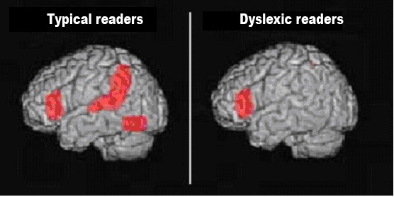
I used a different part of my brain to read.

Slide 12
Myths about Dyslexia
Do NOT see letters backward or upside down
Does NOT effect mostly boys
Is NOT a vision problem
Does NOT mean I am dumb, lazy or less intelligent

Slide 13
My History
4-6 Bullet Points about your LD History

Slide 14
My Dyslexia
4-6 Bullet Points about how your dyslexia affects you

Slide 15
Accommodations
List the accommodations you have in school

Slide 16
The Assistive Technology I Use
List the assistive technologies you use

Slide 17
Strengths
List your strengths in school

Slide 18
Support
List what you need you teacher to do to support you

Slide 19
My Committment
Make a commitment to your teachers to do your best

Slide 20
Thank you!
I invite you to join my team and together let’s make this an awesome year!

